Slide 1
Overview

Slide 2
Innovative data, tools and services - the next generation of research information
Dimensions was created in an era of increasingly available information on the research lifecycle globally, from awarded grants all the way through to resulting intellectual property, clinical trials and policy.
We provide an unprecedented wealth of this data, up-to-date, connected and in one place.
Our technology and expertise help you make sense of this large amount of information to inform strategic and practical decision-making.
Enriched metadata
Expertise
Tools
Multiple data delivery options
Robust search mechanisms
Insights

Slide 3
It’s better to be inclusive
At Dimensions, we believe in our users.
It’s our mission to provide you with as much important and timely data as we can deliver, and to empower you with tools and resources that allow you to draw from this vast corpus in ways most suited to your specific needs.
We know that having access to the largest set of data - not a narrow, exclusionary set - enables you to make the most informed decisions, and we believe that you are in the best position to determine what’s important for yourself and your organization.
We’re here to help!

Slide 4
Publication indicators in Dimensions
Publication citations
The publication citations value is the number of times that a publication has been cited by other publications in the database.
Recent citations
The recent citations value is the number of citations that were received in the last two years. It is currently reset at the beginning of each calendar year.
Field Citation Ratio (FCR)
The Field Citation Ratio (FCR) is an article-level metric that indicates the relative citation performance of an article, when compared to similarly-aged articles in its subject area. A value of more than 1.0 indicates higher than average citation, when defined by Field of Research Subject Code, publishing year and age. The FCR is calculated for all publications in Dimensions which are at least 2 years old and were published in 2000 or later.
Altmetric Attention Score
The Altmetric Attention Score is a weighted count of all of the online attention Altmetric have found for an individual research output. This includes mentions in the mainstream news, social networks, Wikipedia, blogs and more.
Relative Citation Ratio (RCR) The Relative Citation Ratio (RCR), developed by the National Institutes of Health (US), indicates the relative citation performance of an article when comparing its citation rate to that of other articles in its area of research. A value of more than 1.0 shows a citation rate above average. The article’s area of research is defined by the articles that have been cited alongside it. The RCR is calculated for all PubMed publications which are at least 2 years old.

Slide 5
PUBLICATIONS
Full text indexing for ~70% of publications
Direct relationships with >130 publishers
Journal articles, books, book chapters, proceedings, preprints
Linked to:
publication references
citing publications
supporting grants
referencing clinical trials
referencing patent records
referencing policy documents
and 90+ other publishers

Slide 6
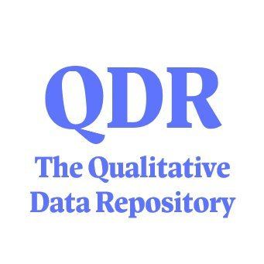
DATASETS
DATACITE
31M+ datasets
Sourced from DataCite and Figshare
Linked to publications, supporting grants and funders
Filters for research organizations, funders, researchers and more
900+ more
FIGSHARE & FIGSHARE HOSTED REPOSITORIES
70+ more

Slide 7
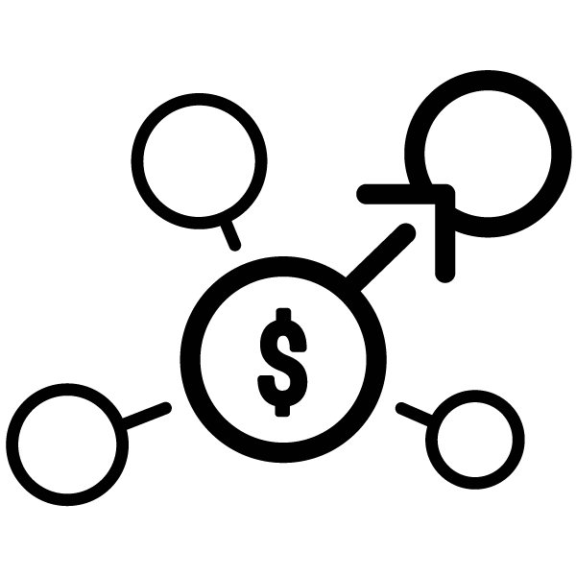
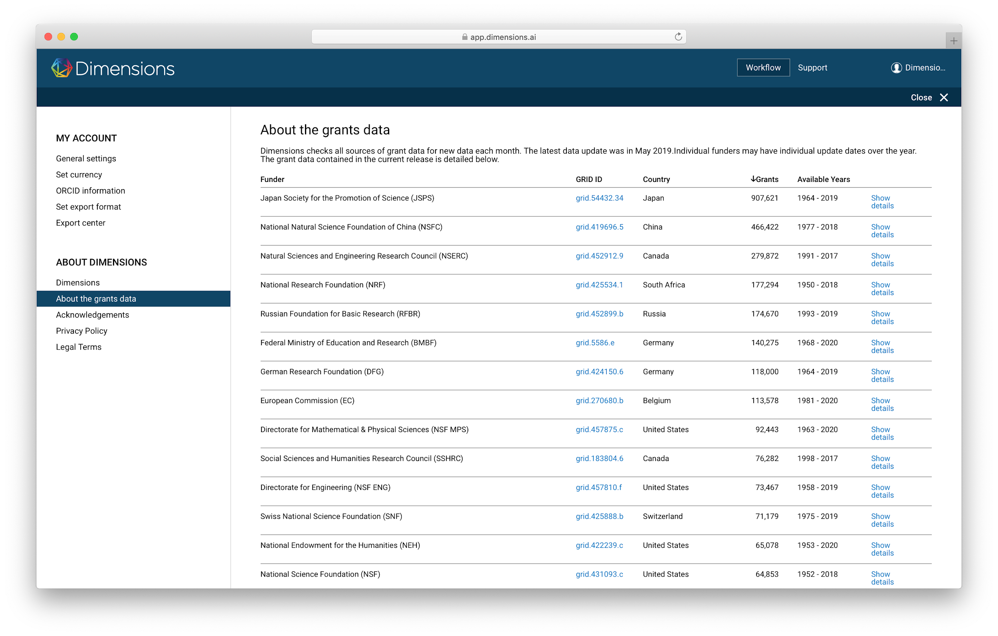
GRANTS
Project funding
Over 7.1M grants from 700+ funders globally
Not limited to national/federal funding
$2 trillion of funding
Sourcing
Direct relationships with funders
Data available via APIs
Data available via websites which we crawl

Slide 8
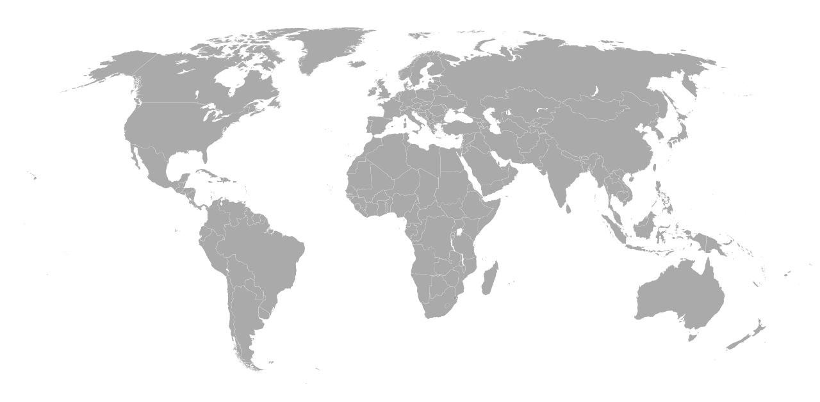
PATENT RECORDS
162M+ patent documents
Global coverage
100+ jurisdictions, including but not limited to:
China
Japan
United States
Germany
European Union
South Korea
See also: https://www.ificlaims.com/docs/CLAIMS+Global+Data+Coverage.htm

Slide 9
CLINICAL TRIALS
ANZCTR (Australia/New Zealand)
CHICTR (China)
ClinicalTrials.gov (United States)
CRIS (Korea)
CTRI (India)
ENCePP (Netherlands)
EU-CTR (EU)
GCTR (Germany)
IRCT (Iran)
ISRCTN (International)
jRCT (Japan)
NTR (Netherlands)
PACTR (Africa)
ReBEC (Brazil)
UMIN-CTR (Japan)
Notes:
ClinicalTrials.gov (United States), EU-CTR (EU), UMIN-CTR (Japan), ISRCTN (International), ANZCTR (Australia/New Zealand), CHICTR (China), NTR (Netherlands), GCTR (Germany), CRIS (Korea), CTRI (India) and ICRT (Iran).

Slide 10
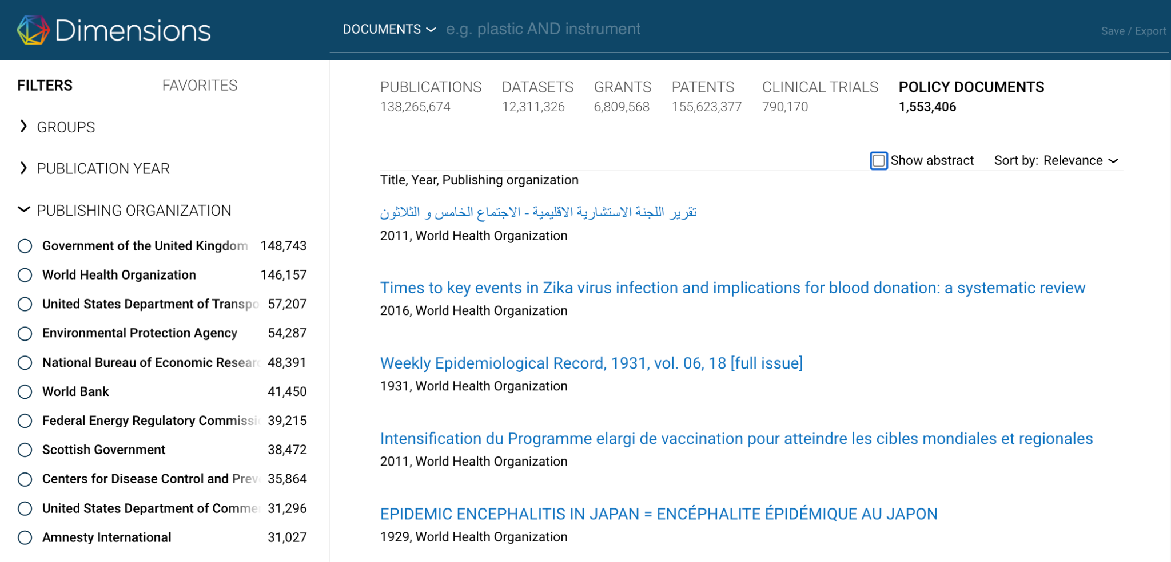
POLICY DOCUMENTS
Over 2M policy document records, linked to publications
Including but not limited to:
World Health Organization
World Bank
Centers for Disease Control & Prevention
Government of the United Kingdom
National Bureau of Economic Research

Slide 11
Get the data and insights you need from a more comprehensive landscape
Research
Data sets
News, Social Media
Clinical
Trials
Policy docs
Grants
Proceedings Preprints
Publications
Citations
Patents
Pre-publication
Post publication
1-5 years from grant to publication
immediate
2-3 years
years
years
decades

Slide 12
Content & links

Slide 13
Content and links in Dimensions
146m
Publications 104m full text index
2.5m links
834k
Clinical trials
567k links
21m links
1.9bn links
269m
Altmetric data
points
16m links
162m
Patents
35k links
594k to funders
3.2m links
3m links
24m links 37m to funders
487m links
282k links
374k to funders
2m
Policy documents
7.1m
Grants
$2.5 trillion in funding
31m
Datasets
1.2M links
2m to funders
Status: May 2024

Slide 14
Enrichment

Slide 15
We enrich and organize the data
Incoming data
Dimensions enriched metadata
Enrichment
Institution identification
Organizations
Categorization
Publications
Clinical trials
Classifications
Concept
extraction
Concepts
Altmetric
Patents
Researcher
disambiguation
Researchers
Reference extraction
References
Metrics
Datasets
Grants
Policy
docs
Trust marker identification
Trust markers

Slide 16
Additional data enrichment advantages
Document level classification - consistent over different content types making analysis even easier
Full text indexing for over 70% of publications
First to comprehensively index pre-prints, linked to peer reviewed version of record
Location tagging - easily drill down by geography
Notes:
Update when we have document types (on 6 month roadmap)

